Slide 1
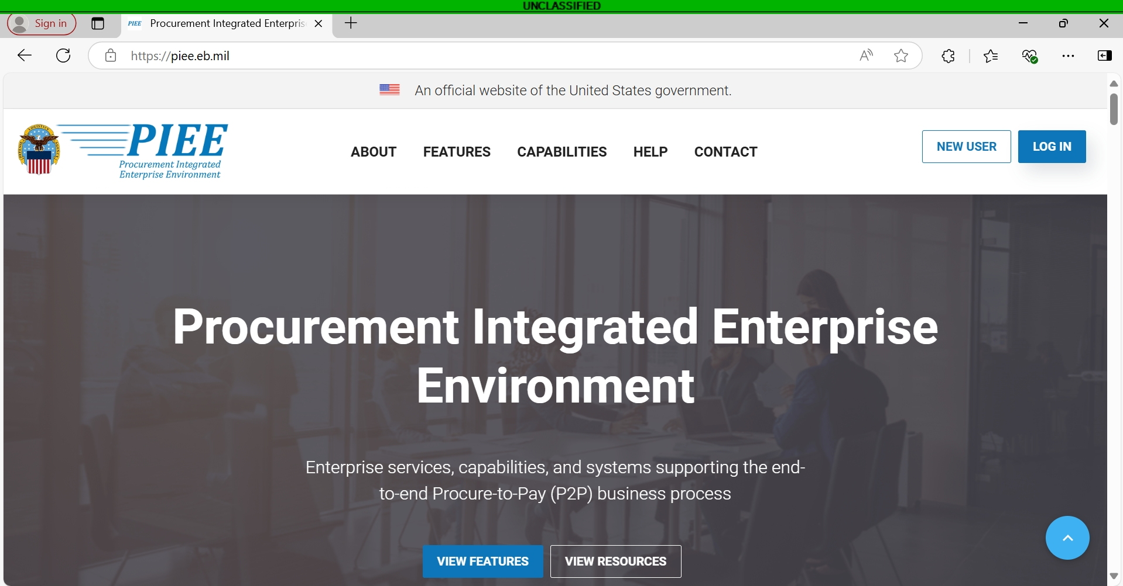

Notes:
Welcome to this instructional video on how to gain access to the Procurement Integrated Enterprise Environment and FEDMALL, presented by the DLA Office of the Chaplain.

Slide 2
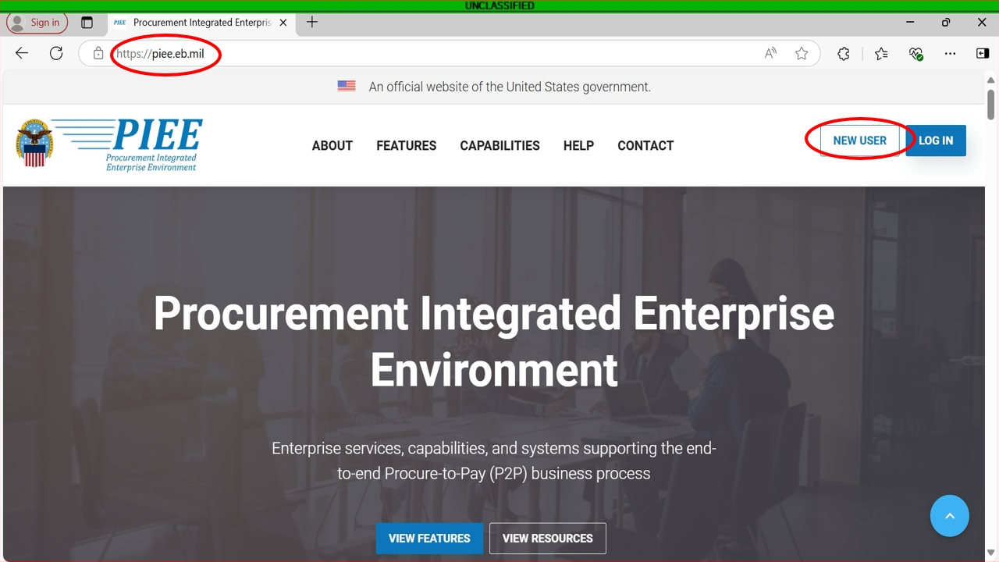
Notes:
First you will need to go to piee.eb.mil. Next you will click on New User. If you already have access to PIEE, please proceed to slide 10, where we go over adding roles.

Slide 3
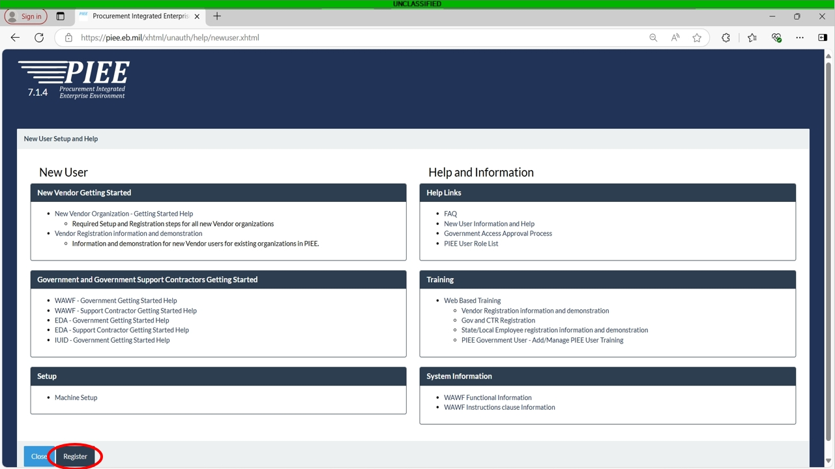
Notes:
This page has great information for help in getting started. There are links to frequently asked questions and web based training. Once you are ready, click on register button on the bottom left of the page.

Slide 4
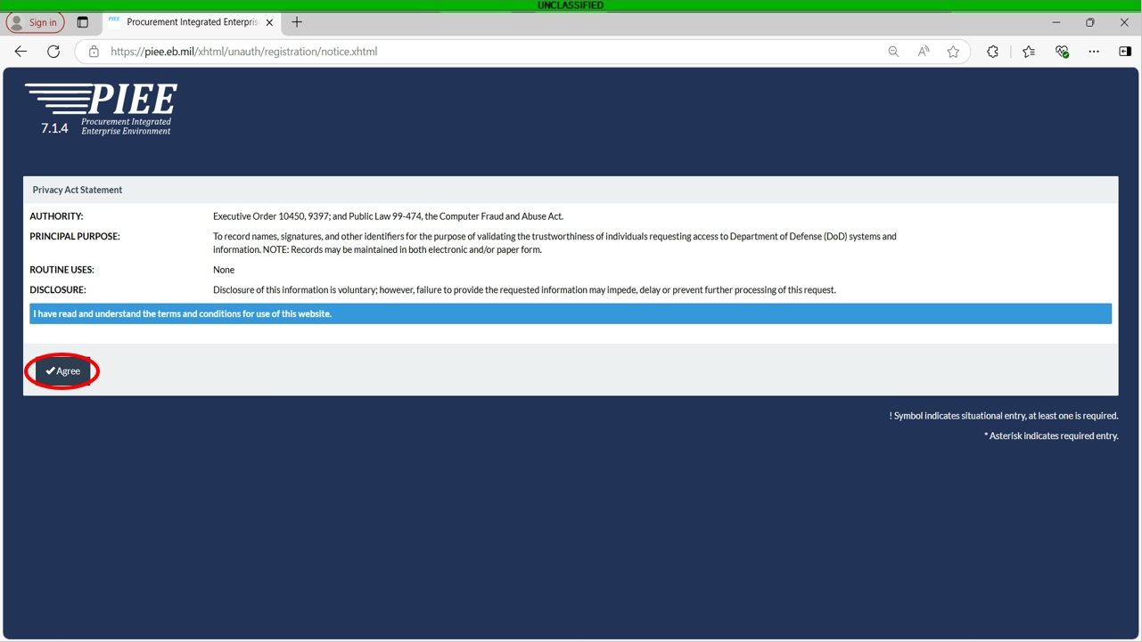
Notes:
Please read the Privacy Act Statement. Once complete, click on Agree.

Slide 5
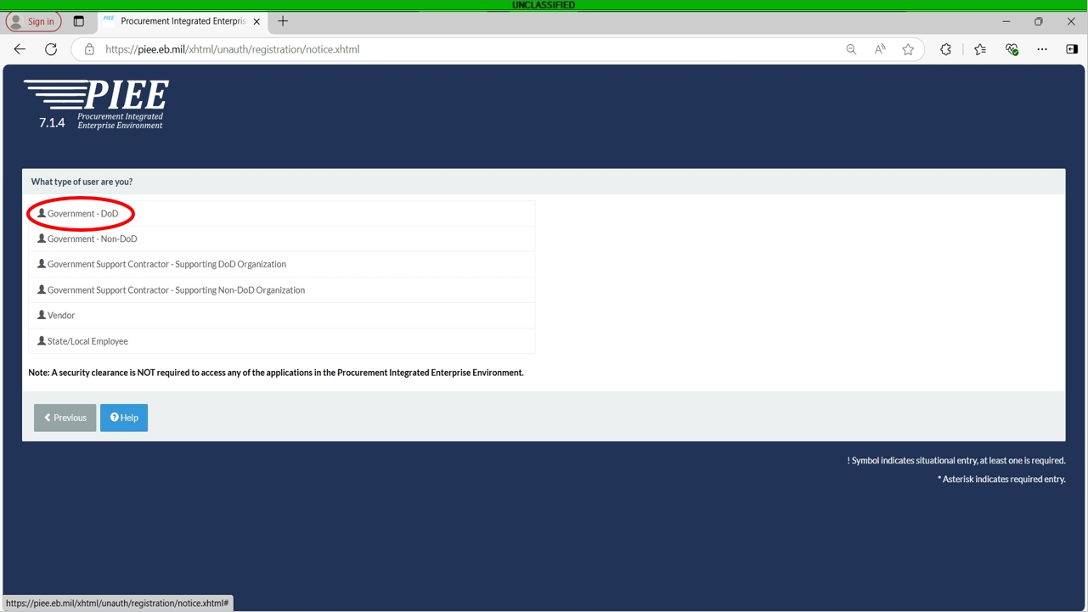
Notes:
On this page, click the first option if you are a Chaplain, Religious Affairs enlisted, or GS working for the Chapel.

Slide 6
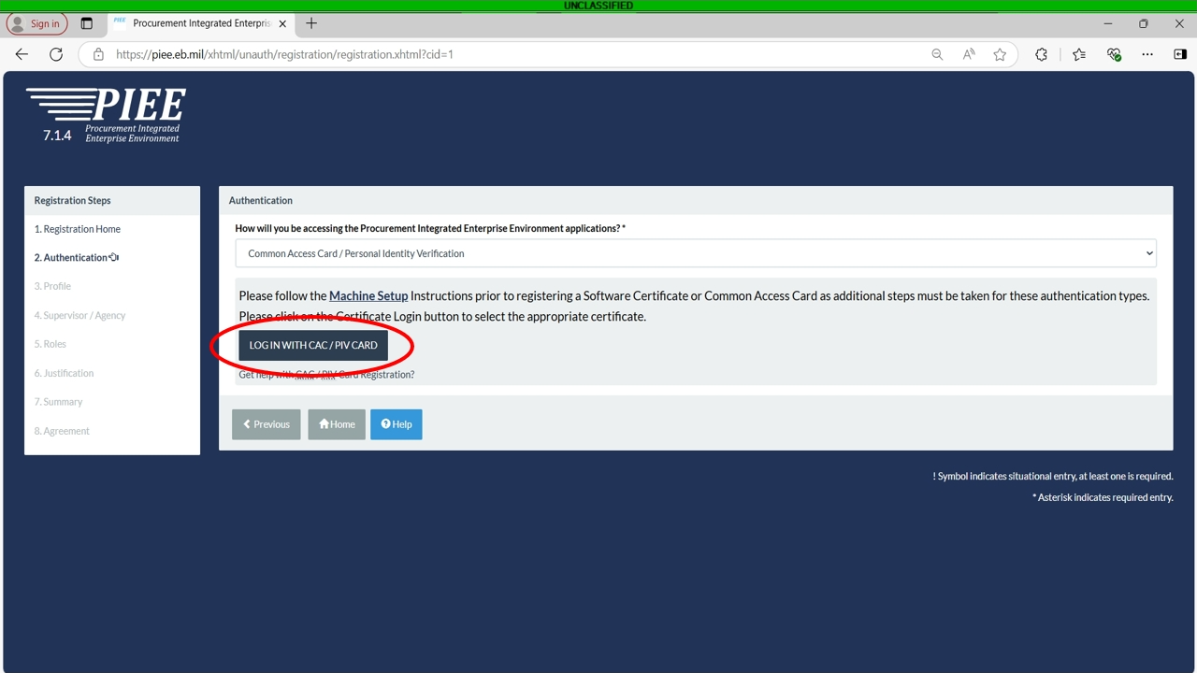
Notes:
Here you will click on “Log in with CAC/PIV Card”

Slide 7
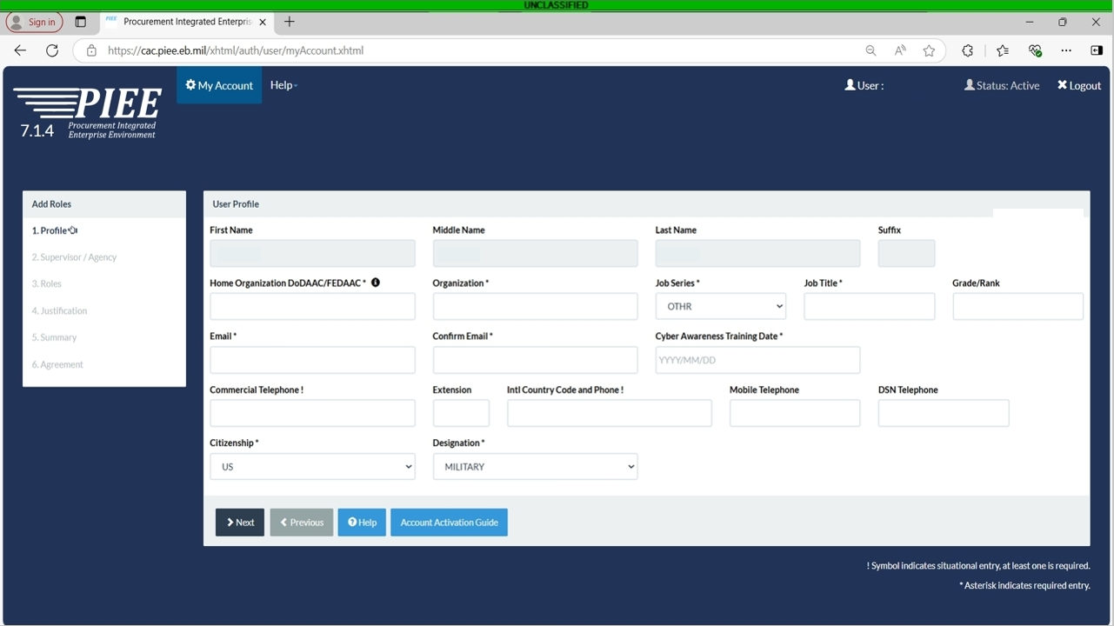
Notes:
Here you will enter all of your profile information. Your name should already be populated. Your Home Organization DoDAAC can be retrieved from your billing official’s office. Your organization is your unit or base. Select OTHR for your job series and title. Enter your grade/rank. Enter and confirm your .mil email address. Input your latest Cyber Awareness Training Date completion. Enter your commercial telephone number and mobile number if you have one. Lastly select your citizenship and designation, whether you are military or civilian. When this is completely filled out, click next.

Slide 8
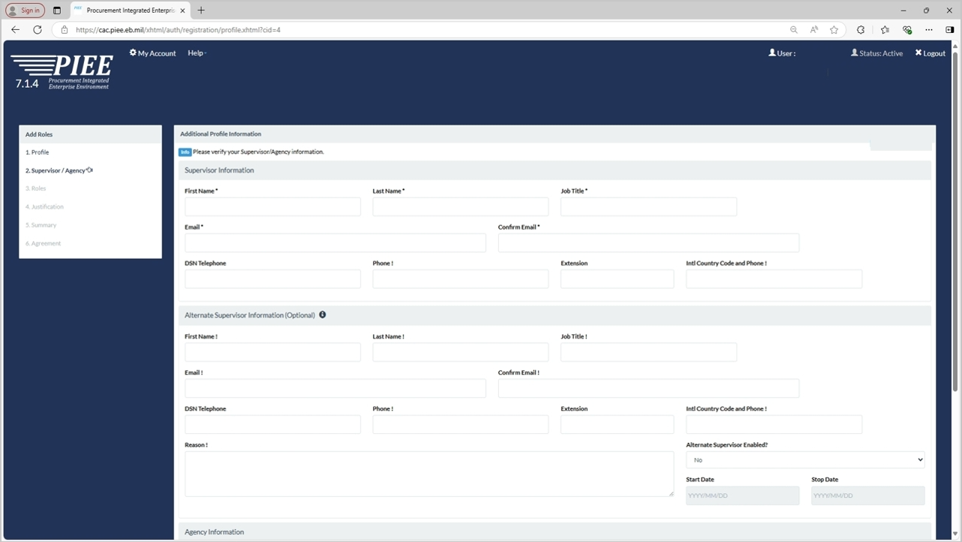
Notes:
On this page you will need to input your Supervisor’s information. This includes their name, job title, .mil email address and phone numbers. Once that information is populated, scroll down to the lower section.

Slide 9
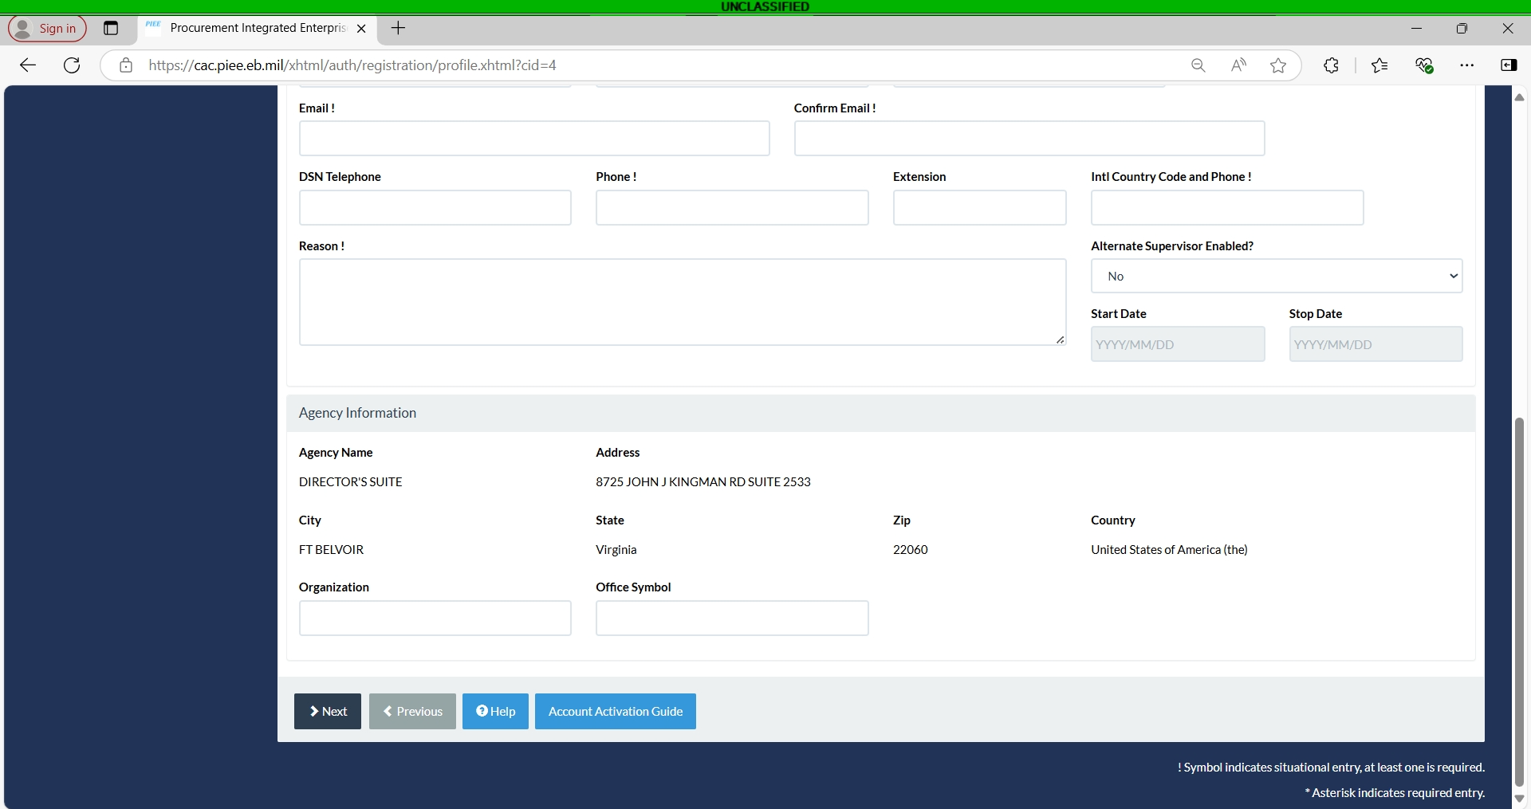
Notes:
In the bottom section, if you entered the right DODAAC, your agency information should be mostly populated. The only open areas should be Organization and Office Symbol. These fields are optional. Once everything is correct, hit next

Slide 10
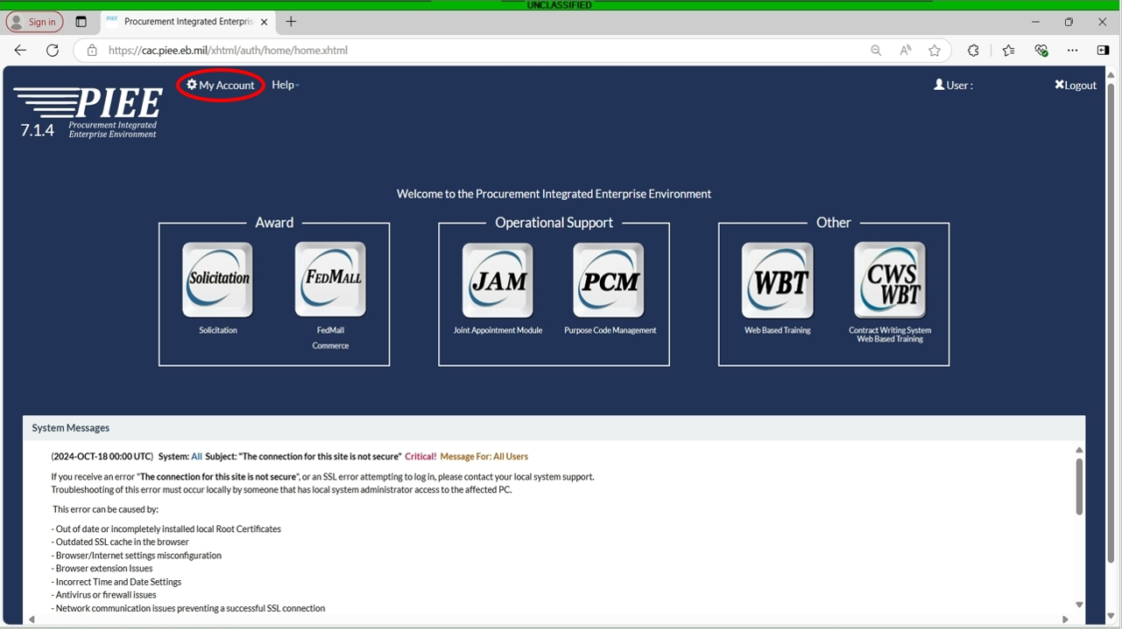
Notes:
If you are still registering on PIEE, we pick back up on slide 15. If you already have access to PIEE, The next section is for adding your role on FEDMALL. Click on My Account in the top left.

Slide 11
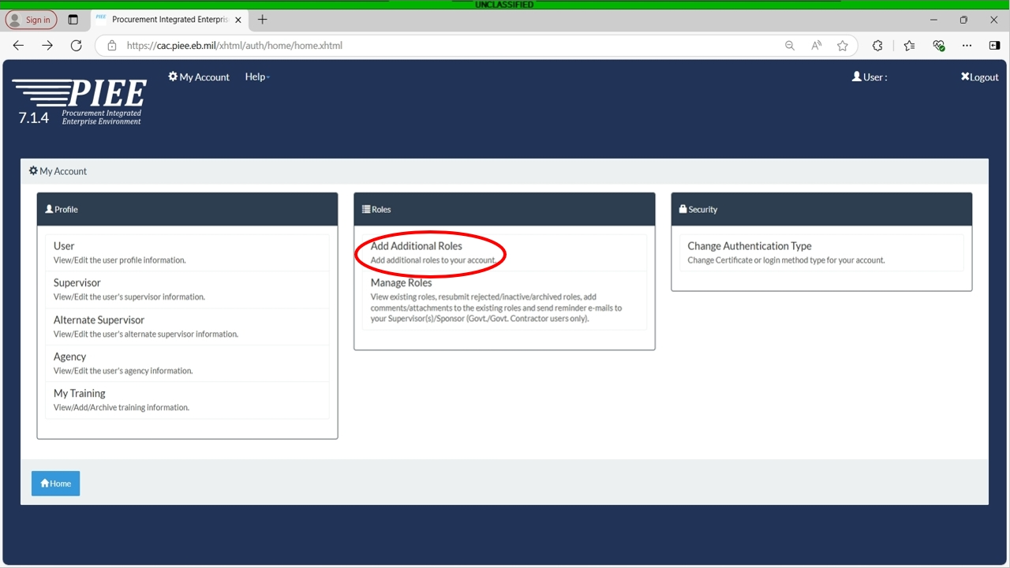
Notes:
Here you will select Add additional Roles.

Slide 12
Notes:
Next, you will verify that all of your profile information is correct. Once verified, click next

Slide 13
Notes:
Here you will either verify or input your supervisor’s information

Slide 14
Notes:
When you scroll to the bottom, you will verify your Agency information. When all information is verified, click next.

Slide 15
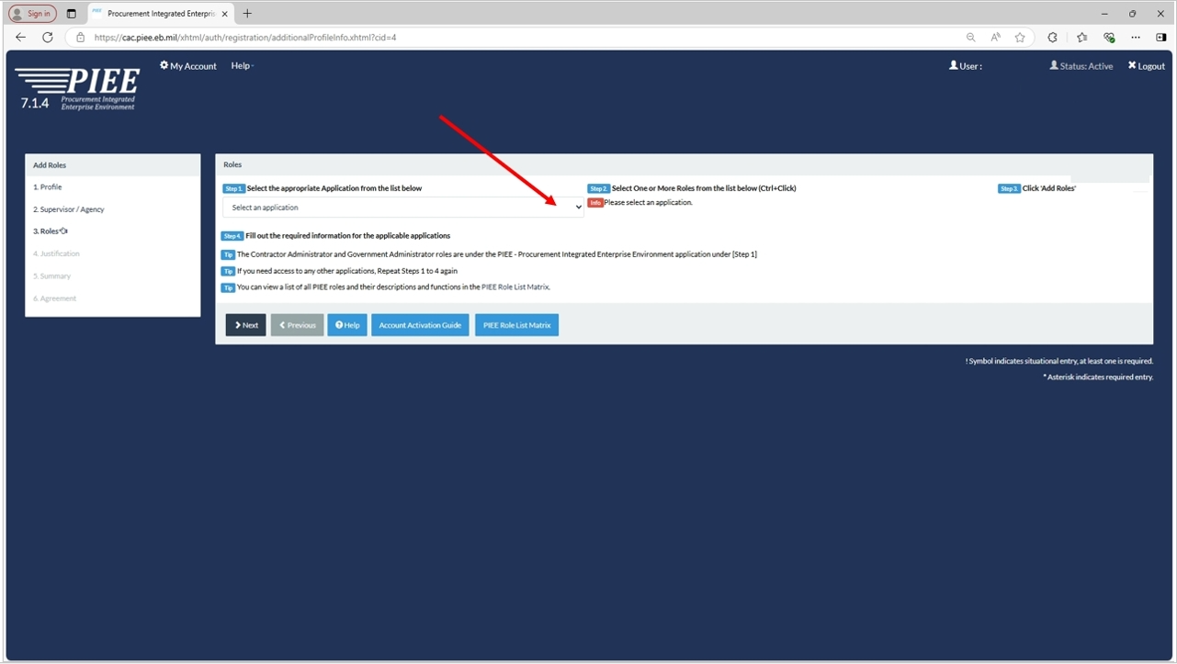
Notes:
On this page, click the dropdown menu

Slide 16
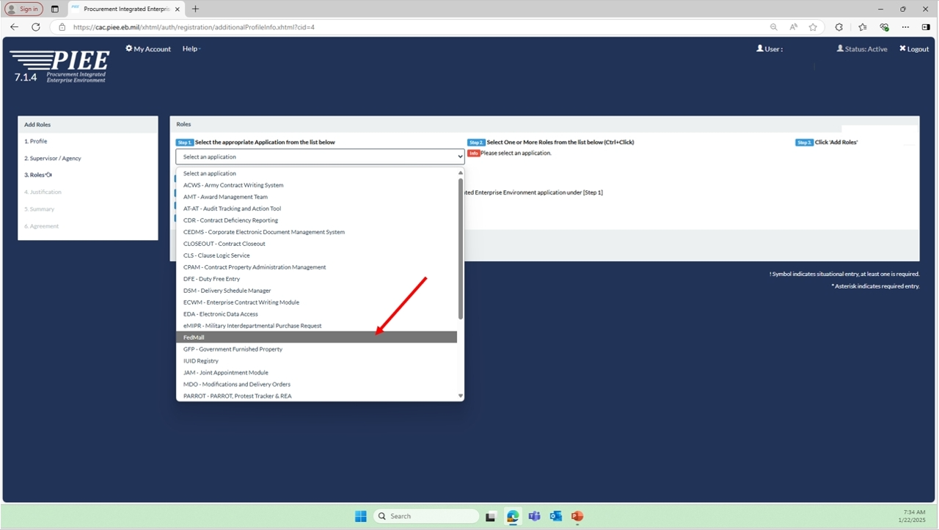
Notes:
In the dropdown menu, select FedMall

Slide 17
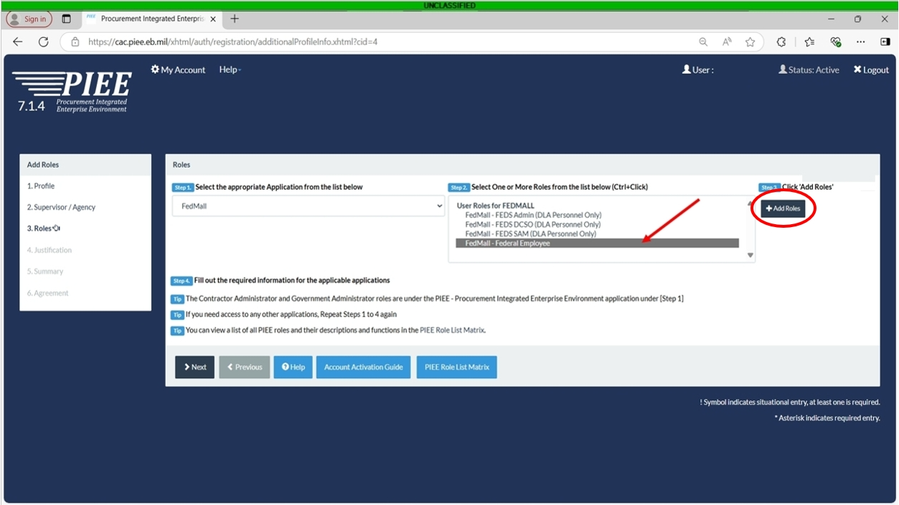
Notes:
In the next section, select FedMall – Federal Employee, then click +Add Roles

Slide 18
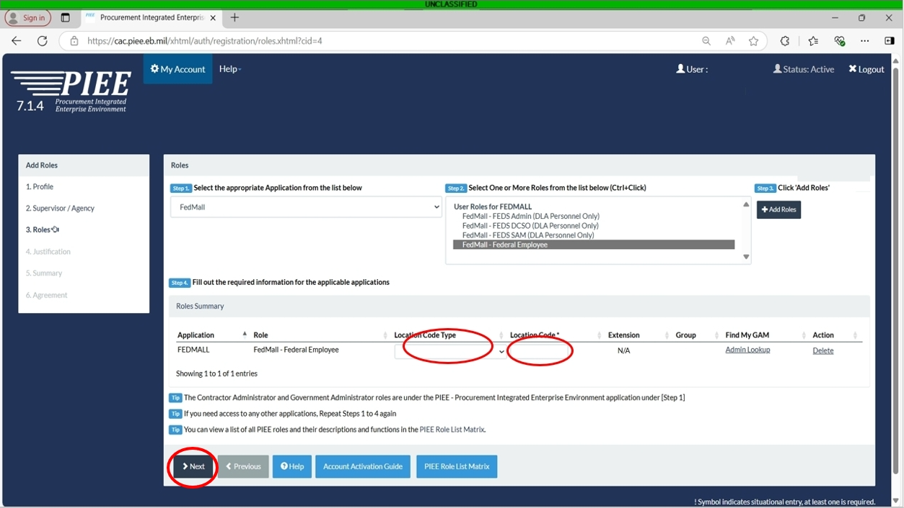
Notes:
Here you will ensure that the Location Code Type is DoDAAC and the location Code is the DoDAAC that you entered previously. If all information is correct, hit next.

Slide 19
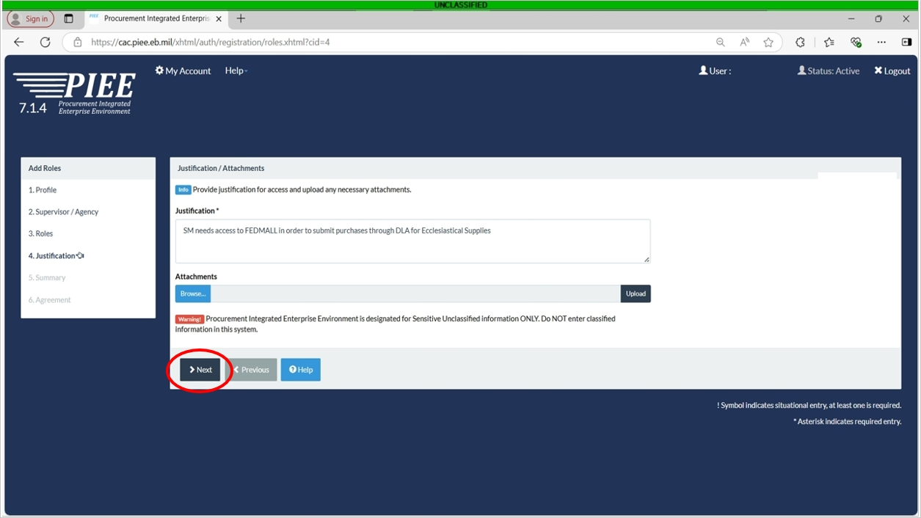
Notes:
Here you will need to fill out the justification on why you need access to FEDMALL. You can copy this justification. “SM needs access to FEDMALL in order to submit purchases through DLA for Ecclesiastical Supplies” When finished, select next. A summary page will pop up. Verify all information contained there. Once verified, click next

Slide 20
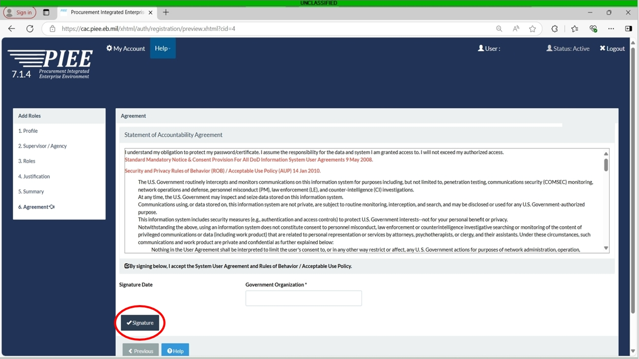
Notes:
Lastly, you will need to read the Statement Of Accountability Agreement. The date should populate and the Government Organization should be your DoDAAC. Once complete, click the Signature button. A small window will pop up, click submit registration.

Slide 21
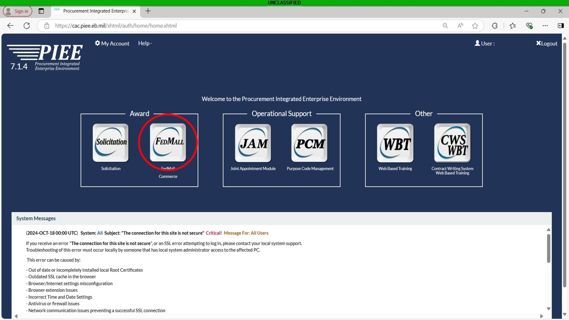
Notes:
Once you have the highlighted button for FEDMALL on your piee home screen, you have access and can use it to access fedmall. Thank you for your attention. If you have any question, please contact the DLA Office of the Chaplain by emailling DLACHAPLAIN@DLA.MIL

